Slide 1
Enabling Business Agility
Generating new business Revenue with existing infrastructure

Slide 2
AGENDA
Current Trends
Use Case Walkthrough
Understand where the industry is demanding for
High Level walkthrough of the solution
Solution and value proposition
Use Case Demonstration
Focus on areas where it provides business outcome
Sample Use Case Demonstration, including architecture walkthrough

Slide 3
Current Trends
API Analytics: Design for Analytics
API as a Product
APIs become brand drivers
Enterprises who embraced APIs break away in their industries

Slide 4





Value Proposition
Security
Standardization
More revenue inflow
Reuse
Data-Driven
Consistent security implementation for application login
Leverage on built-in API-first security practices
Extend existing business services and assets and build new products faster
Transform existing back-end capabilities into secure consumable APIs
Visualize API products usage for decision making

Slide 5
Problem
Case
Study
Walkthrough
Company is exploring a new product line with a Microsite
Solution
Reuse existing enterprise security and application infrastructure
Results
Faster time to market, ensuring proper security, integration implementation, and better visibility to consumer trends

Slide 6
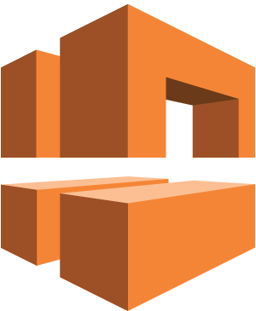
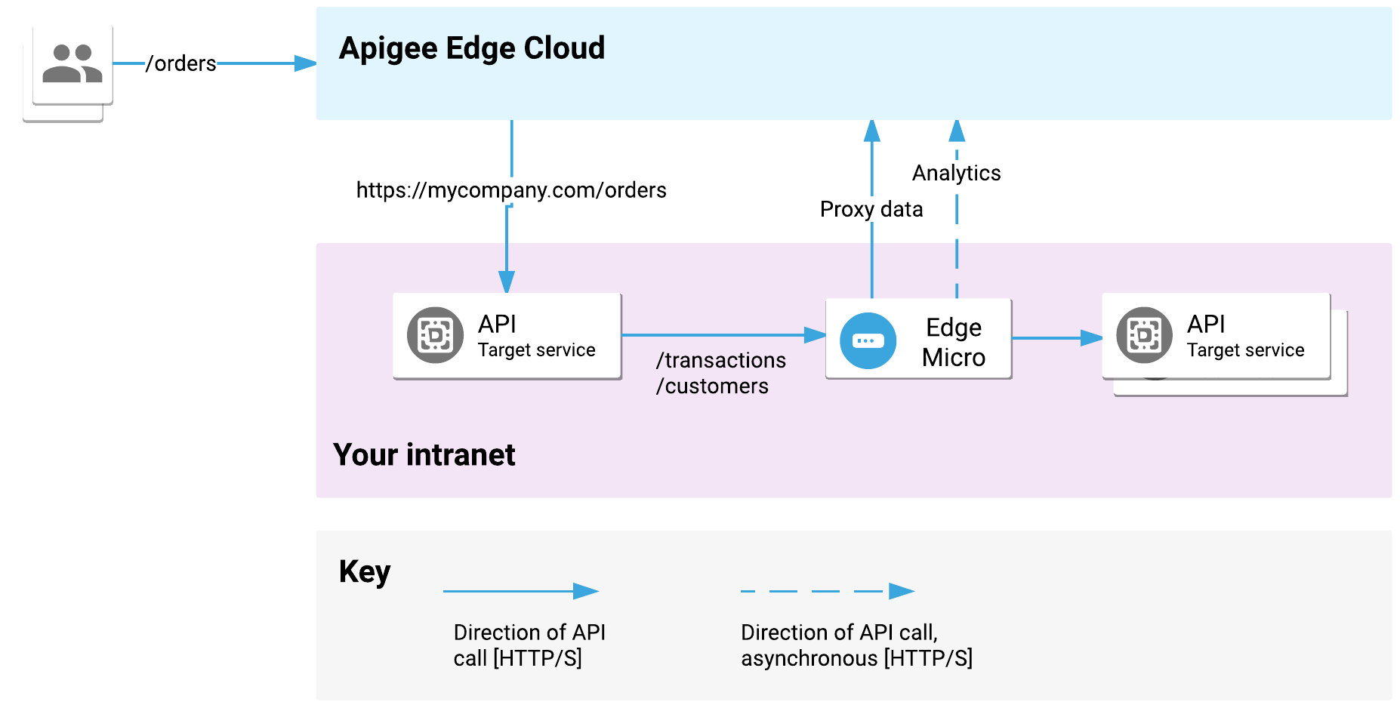


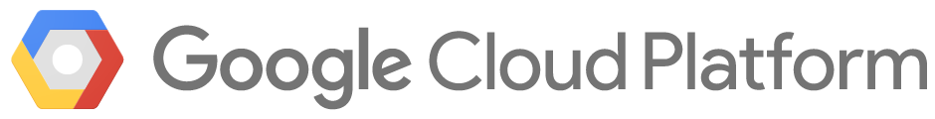
Use Case – Architecture Walkthrough
Amazon VPC*
Amazon EC2
Amazon ES
Kubernetes cluster #FCE4EC
pod #E8F5E9

Slide 7
Conclusions
Using an IAM gateway to implement login solution, ensure consistent Authentication mechanism
Leveraging on existing services for Product Enquiry, reducing the need to develop duplicate services, hence reducing development turnaround
Dashboards which pull data from logs, provides insight to customer product preferences for better decision making
What’s next?

